Slide 1
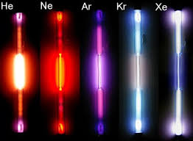
18th GROUP ELEMENTS

Slide 3
OCCURRENCE
Attributable to their stable and inert nature, all the noble gasses occur in the atmosphere in the Free State.
All the noble gasses, helium, neon, argon, krypton and xenon, apart from radon, exist in the environment.
Approximately 1% by volume of the atmosphere is made up of these gasses, of which argon alone constitutes 0.93%.
Argon can be prepared by fractional distillation of liquid air.
The most essential economic and commercial source of helium is the natural gas deposits.
Certain water springs contain neon, helium, and argon as disintegrated gasses.
Radon, a radioactive element is obtained by the decay of radium and thorium minerals.

Slide 4
TRENDS IN SOME OF THE ATOMIC PROPERTIES
ATOMIC RADII
The nuclear radii increment on moving down the group with increasing nuclear number. This is a result of the expansion of another shell at each progressive element on moving down the group. ELECTRON GAIN ENTHALPY
Group 18 elements have stable electronic configurations.
They have zero tendencies to accept any electron. Consequently, they have high positive values of electron gain enthalpy. IONIZATION POTENTIAL
Due to their closed electronic configurations they have high ionization potentials.
Ionization enthalpies decrease step by step on moving down the group with an expansion in the nuclear size.

Slide 5
PHYSICAL PROPERTIES
Because of their stable nature, these elements exist in a free state as monatomic gases.
These elements are tasteless, odourless and colourless gases.
They are sparingly dissolvable in water.
These elements have low melting and boiling points. This is, because of the presence of weak Vander Waals forces responsible for attraction.
The melting and boiling points increments on moving down the group with an expansion in the extent of the Vander Waals forces of attraction.
These noble gases can be condensed at very low temperatures due to the weak Vander Waal forces of attraction. With an expansion in the size of the Vander Waals forces down the group, the ease of liquefaction of noble gases likewise increases.
Helium has the least boiling point among every one of the elements in group eighteen.

Slide 6
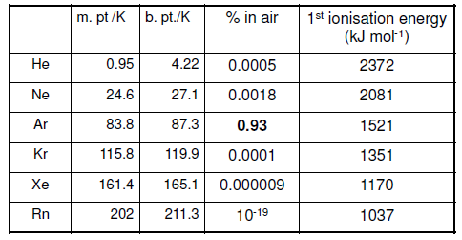

Slide 7
CHEMICAL PROPERTIES
These elements are chemically latent because of their stable electronic configuration.
Group 18 elements have high positive electron gain enthalpy and high ionization enthalpy.
In 1962, Neil Bartlett anticipated that xenon ought to react with platinum hexafluoride. He was the first to set up a compound of xenon, called xenon hexafluoridoplatinate (V)
Xe + PtF₆ → Xe [PtF₆] Xenon Platinum Hexafluoride Xenon Hexafluoridoplatinate (V)
Later, many compounds of xenon were integrated, including fluorides, oxyfluorides, and oxides.
The chemical movement of group eighteen elements increments with a diminishment in the ionization enthalpy on moving down the group.
The ionization enthalpies of helium, argon, and neon are too high for them to shape compounds.
Krypton only forms krypton difluoride, since its ionization enthalpy is marginally higher than that of xenon.
Although radon has less ionization enthalpy than xenon, it shapes just a few compounds like radon difluoride, and a few complexes, since radon has no steady isotopes.

Slide 8
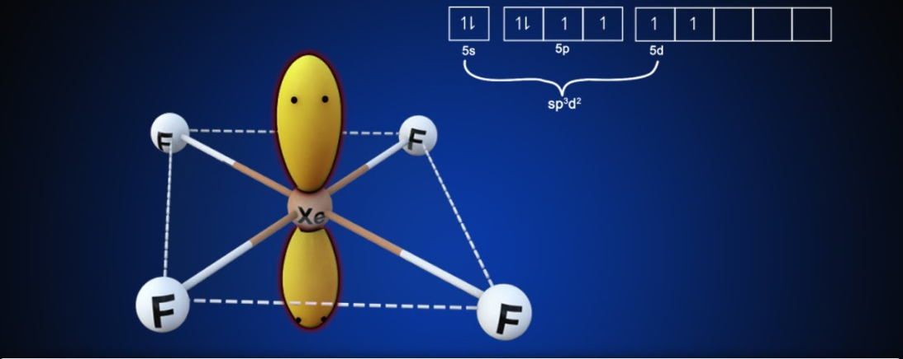

Slide 9
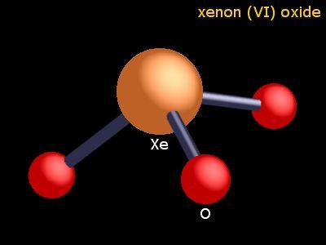
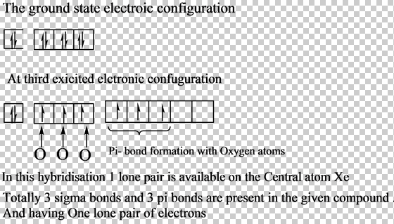

Slide 10
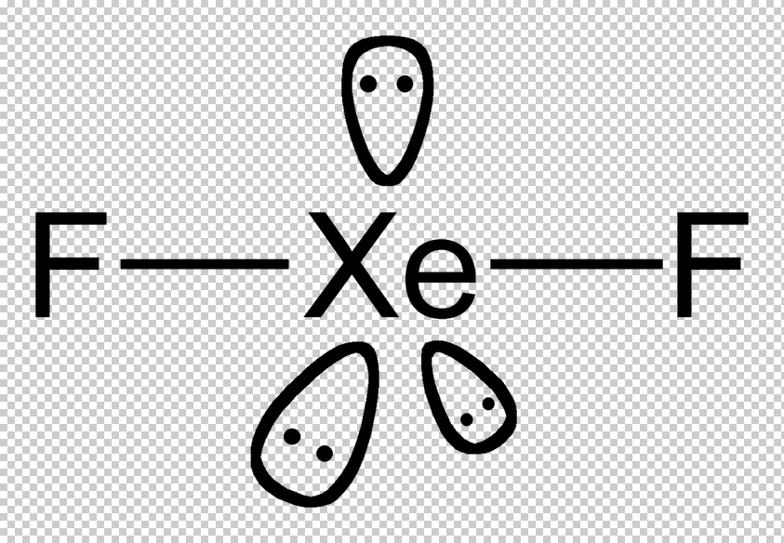

Slide 11
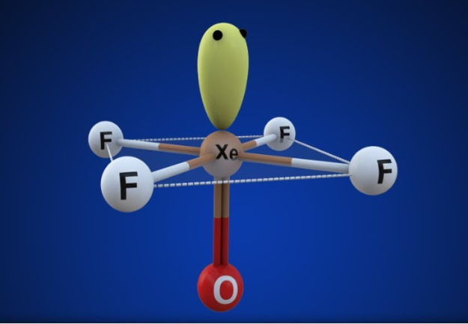

Slide 13
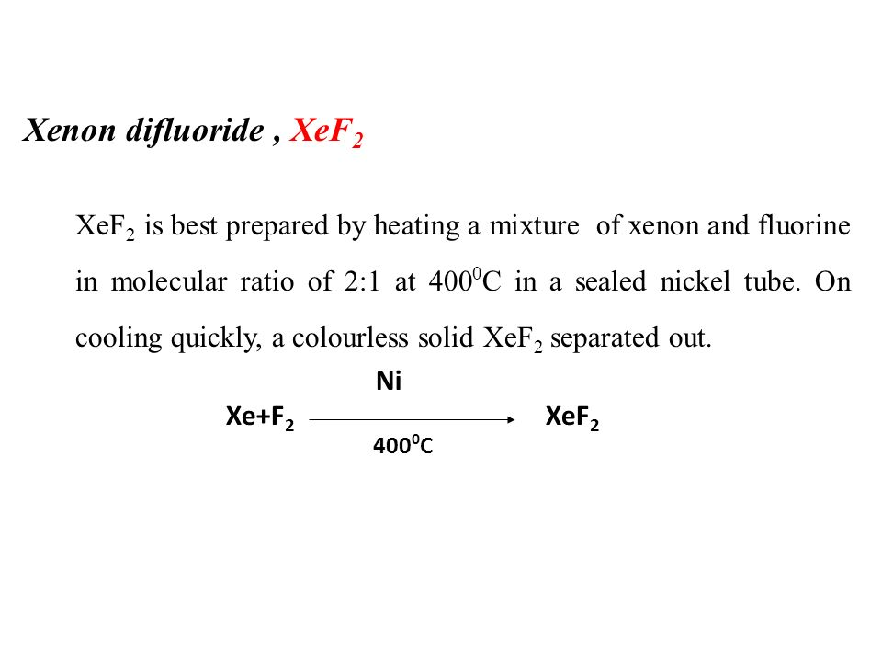

Slide 16
